Slide 1
Conductivity measurement in the food & beverage industry
Selection guide for the best measuring device for cleaning, quality and process monitoring

Slide 2
Table of contents
1. Conductivity measurement in the food and beverage industry Slide 3
2. What is conductivity measurement? Slide 4
3. Measuring principles of conductivity measuring devices Slide 7
4. Measuring device segmentation Slide 12
5. Application descriptions Slide 16
6. Practical example Slide 22

Slide 3
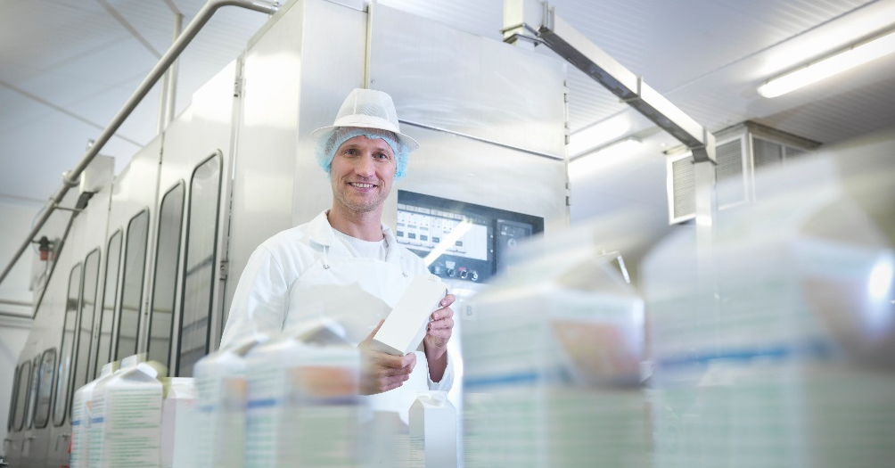
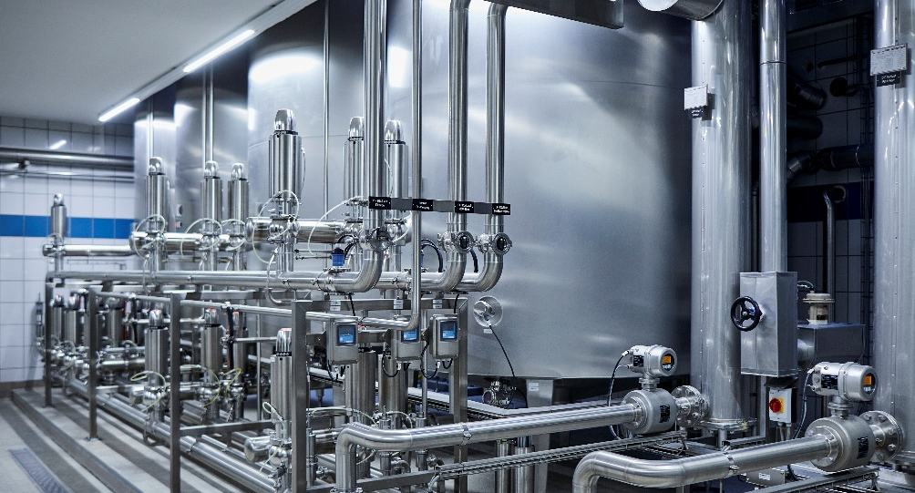
1. Importance of conductivity measurement in process monitoring
~50 %
of all call-backs in the food and beverage industry
are caused by microbiological
contamination. Cleaning in Place (CIP) is therefore a top
priority in processes in the food and
beverage sector.
Your cleaning processes will be perfectly set up with Endress+Hauser's conductivity sensors and, thanks to the high measuring accuracy, you will be able to save up to
~30 %
on cleaning agent
use.

Slide 4
2. What is conductivity measurement?

Slide 5
Conductivity ranges of liquids
0.05 µS/cm
Ultrapure water (0.05 µS/cm)
Pure water (approx. 1 µS/cm)
Drinking water (300 – 800 µS/cm)
Beer (1.5 – 2.5 mS/cm)
Milk (3 – 5 mS/cm)
Orange juice
Apple juice
Tomato juice (15 – 20 mS/cm)
Phosphoric acid
Nitric acid
Caustic soda 2 % (100 mS/cm, 25 °C)
1 µS/cm
Water
10 µS/cm
100 µS/cm
1 mS/cm
10 mS/cm
Foods
100 mS/cm
Process
1000 mS/cm

Slide 6
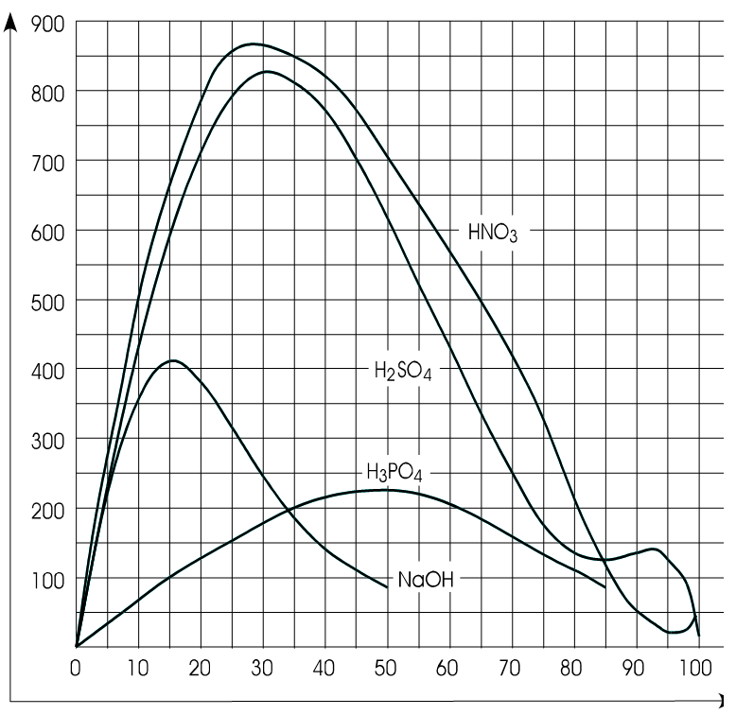
The effect of concentration on conductivity
Conductivity values of strong electrolytes
In strong electrolytes conductivity initially increases with concentration.
The rise in concentration leads to interactions between the ions and thus obstructs their mobility thereby decreasing the conductivity.
Therefore the concentration curve peaks and drops off again after.
Conductivity
(mS/cm at 25 °C)
Concentration (%)

Slide 7
3. Measuring principles of conductivity measuring devices

Slide 8
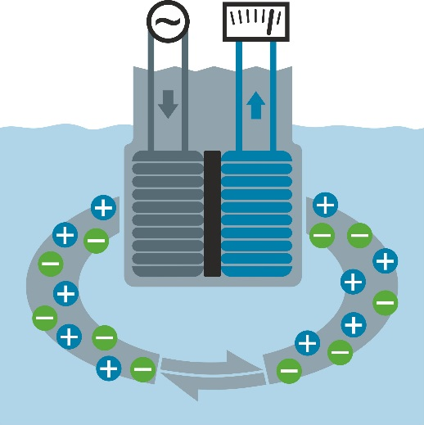
3.1 Inductive conductivity measurement
Smartec CLD134, Indumax CLS54D, Smartec CLD18
During inductive conductivity measurement, a transmission coil generates an alternating magnetic field which induces a voltage in the medium. This sets the positively and negatively charged ions in the fluid in motion and an electric alternating current flows through the fluid.
This current generates an alternating magnetic field in the reception coil. The inductive current generated in the coil is evaluated by the electronics module and the conductivity is determined based on this.

Slide 9
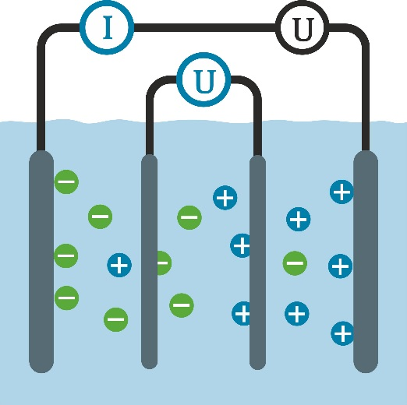
3.2 Conductive conductivity measurement
Sensor with four electrodes: Memosens CLS82D
The four-electrode method is suitable for applications in which a broad measuring range must be covered. Because polarization effects occur at high conductivity values using two-electrode sensors, two additional electrodes are used here to serve as passive observers. They measure the voltage drop in the medium which depends on the conductivity. The connected transmitter determines the voltage and, together with the specified strength of the current, calculates the conductance.

Slide 10
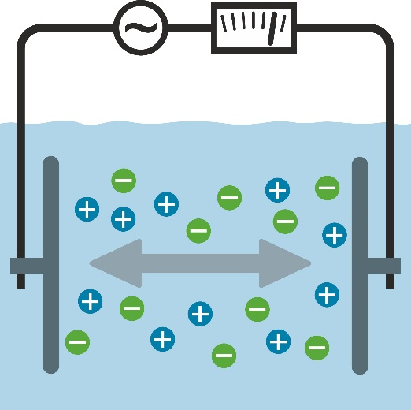
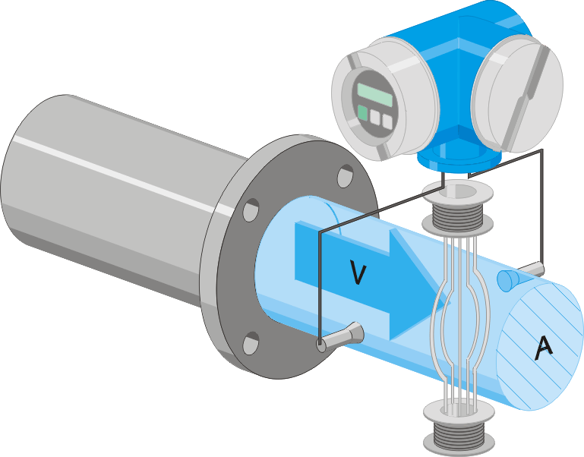
3.3 Conductivity measurement integrated in an inductive flowmeter
Measuring device with two electrodes: Promag H 100/300/500
Conductive conductivity measurement
An alternating voltage is applied and generates a current flow in the medium. The more free charge carriers moving in the fluid, the higher the electrolytic conductivity and current flow. The cell constant is based on the geometry of the electrode arrangement and reflects the distance of the electrodes in relation to their surface.
Inductive flow measurement
According to Faraday's law of magnetic induction, a voltage is induced in a conductor moving through a magnetic field. In the electromagnetic measuring principle, the flowing medium is the moving conductor. The voltage induced is proportional to the flow velocity and is supplied to the amplifier by means of two measuring coils. The flow volume is calculated based on the pipe cross-section.

Slide 11
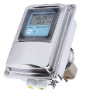
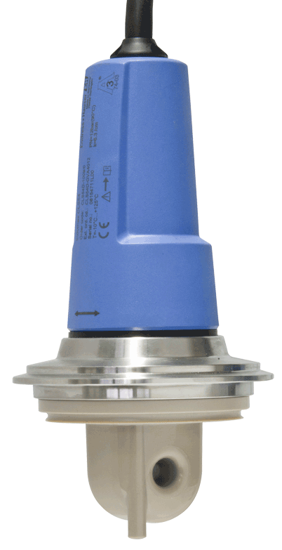
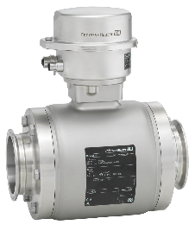
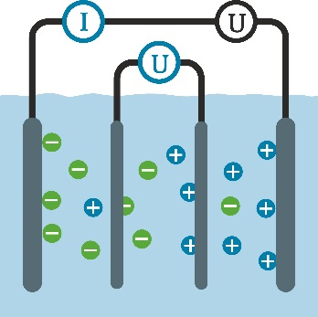
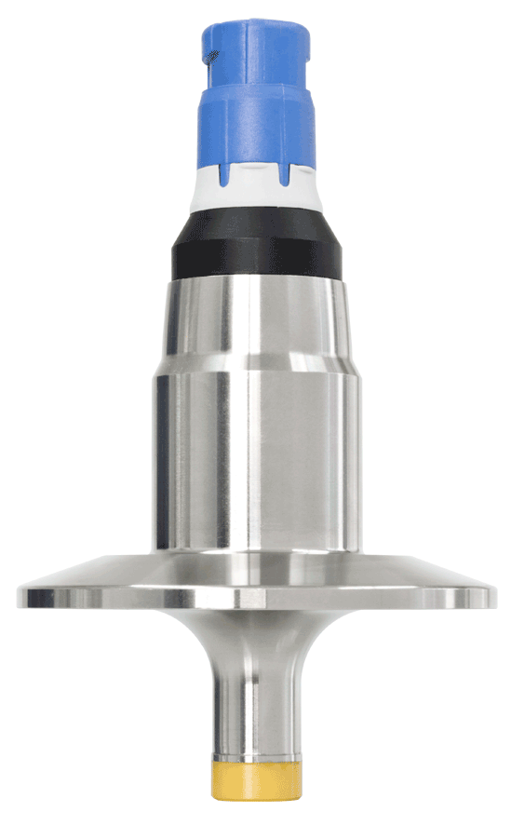
3.4 An overview of measuring principles and products
Inductive conductivity measurement
Smartec CLD134
Indumax CLS54D
Smartec CLD18
Conductive conductivity measurement with two electrodes integrated in an inductive flowmeter
Promag H
Conductive conductivity measurement with four-electrode conductivity sensor Memosens CLS82D

Slide 12
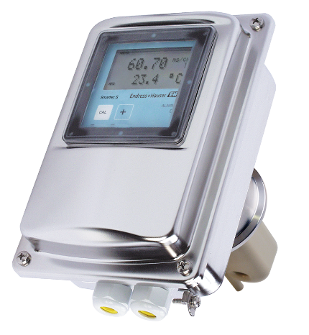
4. Measuring device segmentation

Slide 13
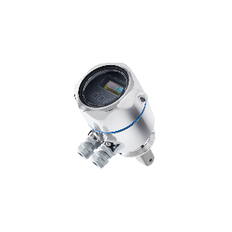
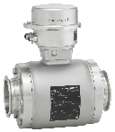
4.1 Overview of conductivity measuring devices
 | Smartec CLD18 | Smartec CLD134 | Indumax CLS54D | Memosens CLS82D | Promag H100
Advantages | Robust sensor for plant engineering IP69K | Measuring range switching Concentration tables Conductivity or concentration display Highly accurate conductivity measurement | Measuring range switching Conductivity or concentration display Digital sensor Memosens Highly accurate conductivity measurement | Measuring range switching Conductivity or concentration display Digital sensor Memosens For small pipe nominal diameters | Flow sensor with integrated conductivity measurement IP69K Small pipe nominal diameters
Measuring range | 0.2 to 1,000 mS/cm, autom. measuring range selection | 0.1 to 2,000 mS/cm, autom. measuring range selection | 0.1 to 2,000 mS/cm autom. measuring range selection | 1 µS/cm to 500 mS/cm | 5 µS to 150 mS/cm
Accuracy | 2 % of the measured value | 0.5 % of the measured value | 0.5 % of the measured value | 4 % of the measured value | Not specified
Reproducibility | 0.5 % of the measured value | 0.2 % of the measured value | 0.2 % of the measured value | 0.2 % of the measured value | +- 1 % of the measured value
Communication | - | Hart, Profi PA, DP | HART, Profi PA + DP,FF, Ethernet/IP, MODBUS | HART, Profi PA + DP, FF, Ethernet/IP, MODBUS | HART, Profi DP, Ethernet/IP, Profinet, MODBUS
Sensor material | Pure PEEK | Pure PEEK | Pure PEEK | Ceramic and platinum, stainless steel | PFA, 316L
Hygiene certificates | 3-A, FDA, (EHEDG pending) | EHEDG, 3-A, FDA | 3-A, EHEDG, FDA | 3-A, EHEDG, FDA | 3-A, EHEDG, FDA
Can be steam sterilized | 130 °C | 150 °C, 1 h | 150 °C, 1 h | 140 °C, 1 h | 150 °C

Slide 14
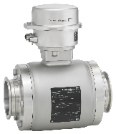
4.2 Overview of measuring ranges
Smartec CLD134, Indumax CLS54D
Inductive
Smartec CLD18
Inductive
Promag H100
Conductive
Memosens CLS82D
Conductive
0.1 1.0 10 100 1 10 100 1000
µS/cm mS/cm

Slide 15
4.3 Segmentation acc. to application
 | Mounting location | Smartec CLD18 | Smartec CLD134 | Indumax CLS54D (with Liquiline) | Memosens CLS82D (with Liquiline) | Promag H 100
CIP acid/base concentration regulation | Tank CIP medium | + | ++ | ++ | - | -
CIP supply | CIP feed line | - | - | - | - | ++ Additional monitoring function
CIP return | CIP return line | + | ++ | ++ | + | -
Product separation (product/water) | Production line | + | ++ | ++ | + | -
Quality control/ product detection | Filling and production line | + | ++ | ++ | + | -
Process monitoring (CIP medium entering product etc.) | Filling & production line | + | ++ | ++ | + | ++ Additional safety

Slide 16
5. Descriptions of applications

Slide 17
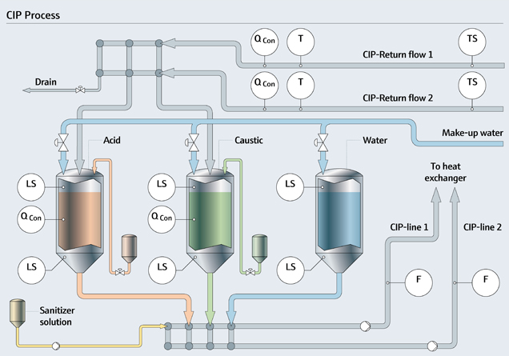
5.1 CIP acid/base concentration regulation
Acid (max. 1.5 %) or base (max. 2 %) in the correct application concentration is held in a receiving tank for the CIP process.
Conductivity measurement in the tank or in the tank bypass regulates the supply of concentrated acid or base to guarantee the correct application concentration.
Requirements: High measuring accuracy, high level of repeatability, calibration capability, fast response time (temperature and conductivity) Savings of CIP medium in the acid/base concentration regulation process Ensures correct CIP concentration
Recommended sensors:
CLD134/ CLS54D CLD18 if display of concentration is not required

Slide 18
5.2 CIP supply
Inductive flow measurement is the control parameter for balancing the CIP process
Flow measurement in the line enables monitoring of the conductivity at the same time
Requirements: High level of repeatability, measured value stability Process safety
Recommended sensor:
Promag H 100

Slide 19
5.3 CIP return/product separation
Conductivity is measured in the return line of the CIP system so that media can either be returned to their appropriate storage tanks following cleaning or discarded.
Sample CIP program
Pre-rinsing with fresh/batch water
Alkaline stage
Intermediate rinsing
Disinfection
Post-rinsing
Requirements: Fast response time for conductivity and temperature as well as a high level of repeatability
Recommended sensors:
Smartec CLD134/Memosens CLS54D CLD18 (accuracy not as high and no measuring range switching)
CLS82D, only for small nominal diameters (accuracy not as high as inductive sensors)

Slide 20
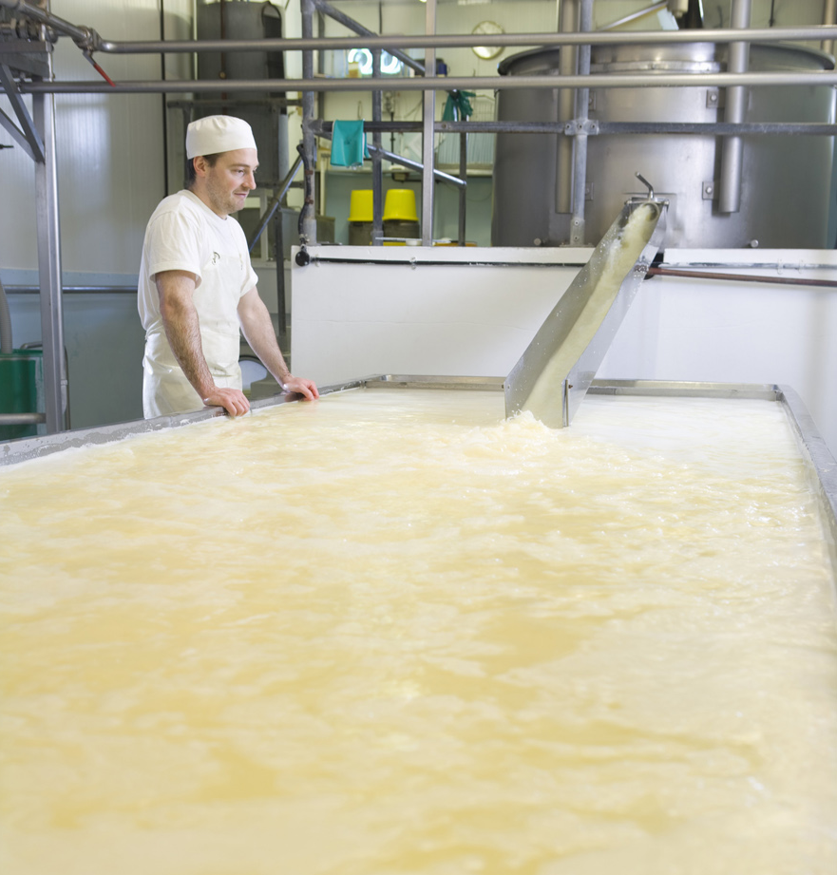
5.4 Quality control/product detection
Given that it is a product-specific variable, the conductivity value can serve as a quality-related parameter. It can also be used for product detection and product separation.
Requirements: High accuracy, fast response time for conductivity, calibration capability.
Recommended sensors:
CLD134/CLS54D
CLD18 (accuracy not as high and no measuring range switching) CLS82D, only for small nominal diameters (accuracy not as high as inductive sensors)
Juice Images/Strandperle

Slide 21
5.5 Product/process monitoring
A conductivity measurement enables monitoring of product quality for undesired effects, e.g., residues before filling or CIP media entering the product.
Requirement: High reproducibility.
Recommended sensors:
CLD134/Memosens CLS54D Promag H 100 together with flow measurement (additional quality control by conductivity measurement)
CLD18 (accuracy not as high and no measuring range switching) CLS82D, only for small nominal diameters (accuracy not as high as inductive sensors)
Monty Rakusen/Cultura Images RF/Strandperle

Slide 22
6. Practical example

Slide 23
6.1 Conductivity measurement in acid/base concentration regulation
Recycling of caustic cleaning solutions with the help of cross-flow filtration in the dairy industry
An average of 2.6 kg of chemicals are used per tonne of processed milk in Swiss dairies for alkaline cleaning and neutralization.
The use of alkaline cleaning chemicals can be reduced by up to 70% by recycling the solutions.
In addition to the savings of 1.8 kg of chemicals per tonne of processed milk, the load in the wastewater is also significantly reduced.

Slide 24
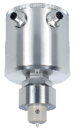
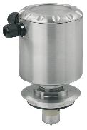
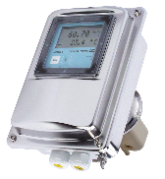
Conductivity measurement in acid/base concentration regulation
Initial situation in sample company
Acid/base concentration regulation: NaOH 1% = 53 mS/cm
 | Competitor device 1 | Competitor device 2 | Smartec CLD134
Measuring range | 0 to 999 mS/cm 14 measuring ranges | 0.5 to 2,000 mS/cm 14 measuring ranges | 0.1 to 2,000 mS/cm Autom. measuring range selection
Accuracy | 2 % of measuring range | 1 % of measuring range | 0.5 % of measured value
50 % NaOH | Approx. 600,000 kg/year | Approx. 600,000 kg/year | Approx. 600,000 kg/year
Resolution | 0.1 % NaOH | 0.04 % NaOH | 0.005 % NaOH
Safety overdosage/year | 1,200 kg | 480 kg | 60 kg

